Slide 1
PE Extra-Curricular Programme
Join an extra-curricular sports club to have fun and learn.
Perform
Coach
Officiate
Sign up for a club with Mr Critchlow and register at the beginning of the session with the teacher.
Active body, active mind. Get the most out of physical education at school.
Passionate about a sport? Talk to Mr Critchlow about it being added to the programme.

Slide 2
What’s On?
 | Monday | Tuesday | Wednesday | Thursday | Friday
During School
Astro being used for lessons
Astro being used for lessons
Football
Year 10
AMC
Football
Year 8
EBI
Football
Year 8/10
Duty Team
Astro being used for lessons
Football
Year 11
CCR
Football
Year 7
AGR
Football
Year 9
DWE
Football
Year 7
NSH

Slide 3
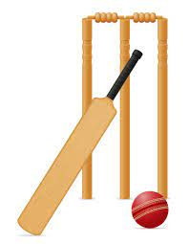
What’s On?
 | Monday | Tuesday | Wednesday | Thursday | Friday
After School | No clubs due to staff meetings
Tennis
Mixed – KS3
AMC
Cricket
Mixed – KS3/4
CCR
Athletics
Mixed – KS3
SWE/AGR
Basketball
Mixed – Y7 to 11
PE Department
Rounders
Mixed – KS3
NSH
Cycling
Mixed – Y7/8/9
JPR
Ambassador Meeting
AMC/DWE
Intervention
Mixed – Y10/11
PE Department

